Slide 1
JNANA MARGA TECH.
Class 2
Basics of python for data science

Slide 2
Check for :
Python version in command prompt –python version
Install ANACONDA + launch jupter notebook :
Through cmd and anaconda
Create python file using .py extension
Benefits and features of python
Focus on being a good programmer by inculcating habits of consistent programming
Practice and working on problem solving ability

Slide 3
WELCOME TO PYTHON
PYTHON is a high level and an object oriented programming language.
PYTHON language is used in a wide range of work .
For example :
Web Development
Software development
Scripting
AI/ML
Mathematics etc.
BENEFITS OF PYTHON OVER OTHER LANGUAGES
Can work across a range of different platforms (for eg. Linux , windows and MAC)
Easy syntax which is similar to the English language.
Automatic memory management.
No requirement of a compiler. PYTHON is a self interpreted language.
Shorter, more flexible codes
One doesn’t not need to specify the data types.

Slide 4
Compilers and Interpreters
Programs written in high-level languages must be translated into machine language to be executed
Compiler: translates high-level language program into separate machine language program
Machine language program can be executed at any time

Slide 5
Compilers and Interpreters (cont’d.)
Interpreter: translates and executes instructions in high-level language program
Used by Python language
Interprets one instruction at a time
No separate machine language program
Source code: statements written by programmer
Syntax error: prevents code from being translated

Slide 6
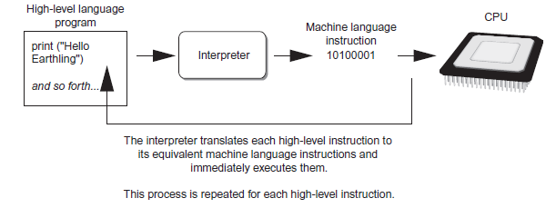
Compilers and Interpreters (cont’d.)
Executing a high-level program with an interpreter

Slide 7
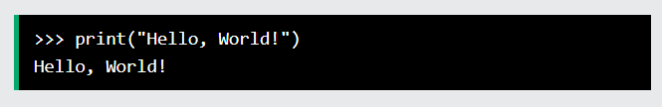
Execute Python Syntax
As we learned in the previous page, Python syntax can be executed by writing directly in the Command Line:
Or by creating a python file on the server, using the .py file extension, and running it in the Command Line:

Slide 8
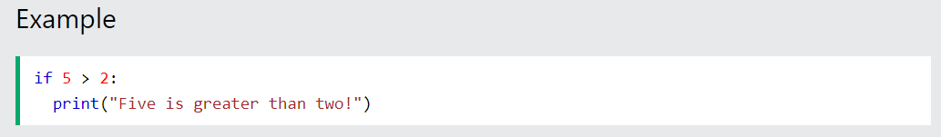
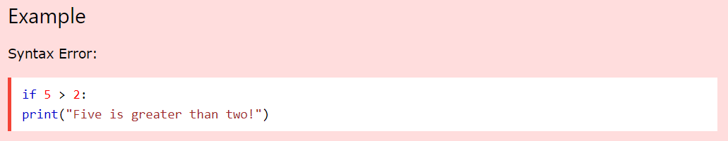
Python Indentation
Indentation refers to the spaces at the beginning of a code line.
Where in other programming languages the indentation in code is for readability only, the indentation in Python is very important.
Python uses indentation to indicate a block of code
Python will give you an error if you skip the indentation:

Slide 9
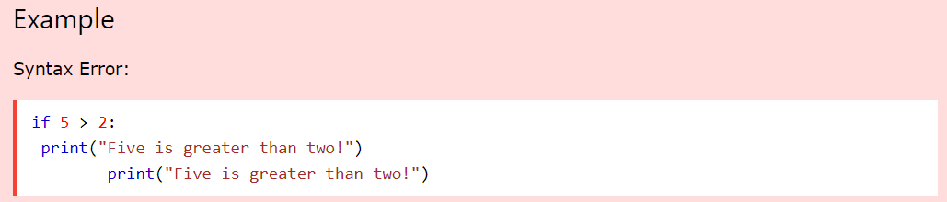
The number of spaces is up to you as a programmer, but it has to be at least one.
You have to use the same number of spaces in the same block of code, otherwise Python will give you an error:

Slide 10
Whitespace
Whitespace is meaningful in Python: especially indentation and placement of newlines
Use a newline to end a line of code
Use \ when must go to next line prematurely
No braces {} to mark blocks of code, use consistent indentation instead
First line with less indentation is outside of the block
First line with more indentation starts a nested block
Colons start of a new block in many constructs, e.g. function definitions, then clauses

Slide 11
Enough to Understand the Code
Indentation matters to code meaning
Block structure indicated by indentation
First assignment to a variable creates it
Variable types don’t need to be declared.
Python figures out the variable types on its own.
Assignment is = and comparison is ==
For numbers + - * / % are as expected
Special use of + for string concatenation and % for string formatting (as in C’s printf)
Logical operators are words (and, or, not) not symbols
The basic printing command is print

Slide 12
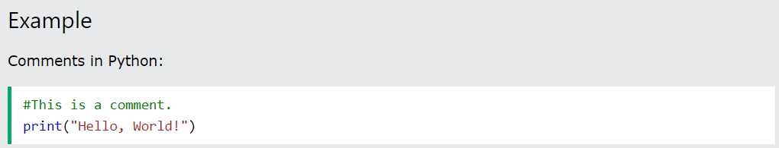
Comments
Python has commenting capability for the purpose of in-code documentation.
Comments start with a ‘#’ , and Python will render the rest of the line as a comment:
Comments can be used to explain Python code.
Comments can be used to make the code more readable.
Comments can be used to prevent execution when testing code.
Comments can be placed at the end of a line, and Python will ignore the rest of the line:

Slide 13
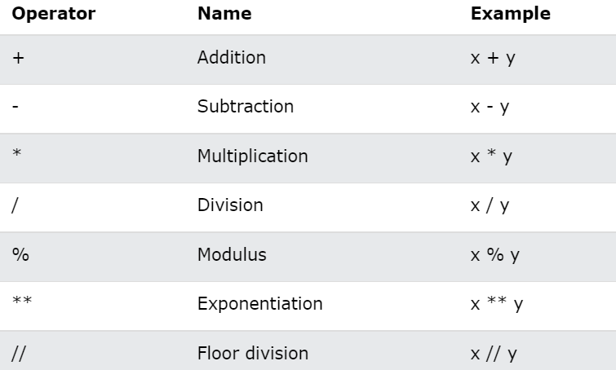
Python Operators
Operators are used to perform operations on variables and values.
In the example below, we use the + operator to add together two values:
Python Arithmetic Operators
Arithmetic operators are used with numeric values to perform common mathematical operations:

Slide 14
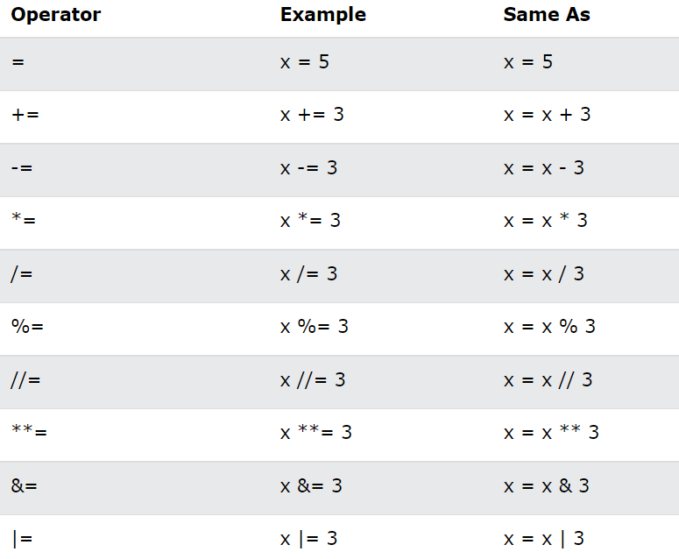
Python Assignment Operators
Assignment operators are used to assign values to variables:

Slide 15
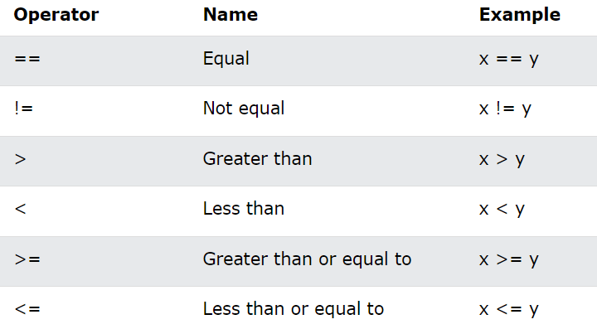
Python Comparison Operators
Comparison operators are used to compare two values:

Slide 16
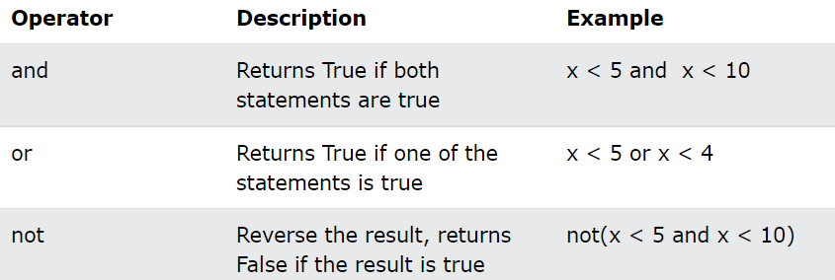
Python Logical Operators
Logical operators are used to combine conditional statements:

Slide 17

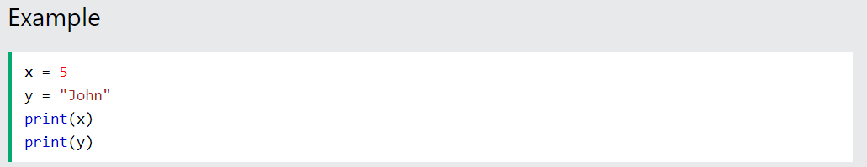
VARIABLES
Variables are containers for storing data values. Imagine variables to be like bucket that get formed in the memory with some data holding ability
Creating Variables
Python has no command for declaring a variable.
A variable is created the moment you first assign a value to it.

Slide 18
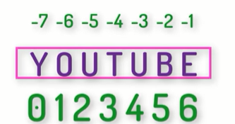
TO Fetch each letter of a string , use indexing, nameofvar[0]
Strings in python are immutable
For example
Print (nameofvar[0])
>>>Y
Print(nameofvar[-1])
>>>E
<someaddress>
To find this address use inbuilt function id(nameofvar)

Slide 19
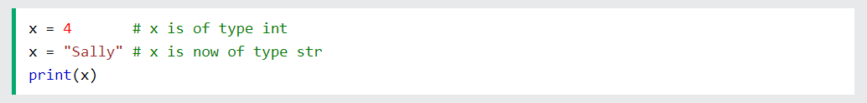
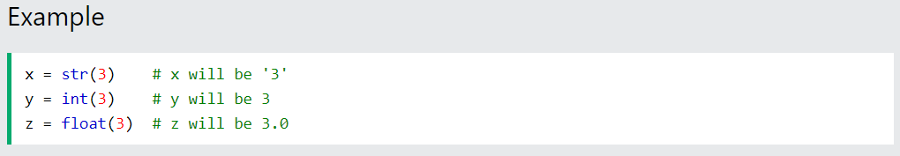
Variables do not need to be declared with any particular type, and can even change type after they have been set
Casting
If you want to specify the data type of a variable, this can be done with casting.

Slide 20
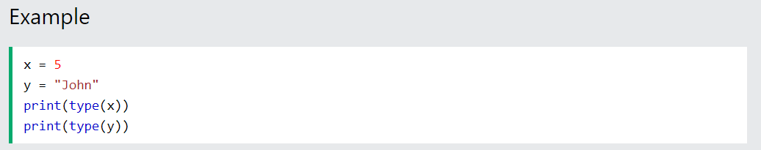
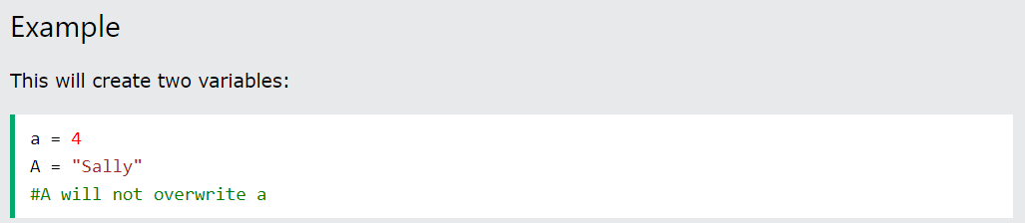
Get the Type
You can get the data type of a variable with the type() function.
Case-Sensitive
Variable names are case-sensitive.

Slide 21
Variable Names
A variable can have a short name (like x and y) or a more descriptive name (age, carname, total_volume).
Rules for Python variables :
A variable name must start with a letter or the underscore
( _ ) character.
A variable name cannot start with a number.
A variable name can only contain alpha-numeric characters and underscores (A-z, 0-9, and _ )
Variable names are case-sensitive (age, Age and AGE are three different variables)

Slide 22
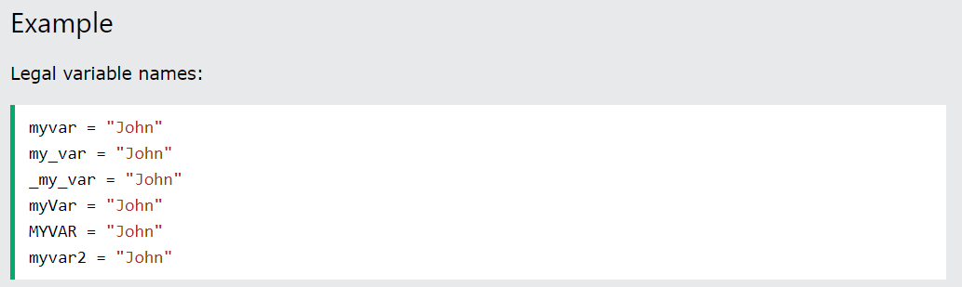
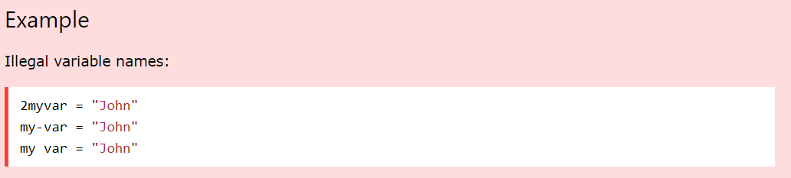

Slide 23
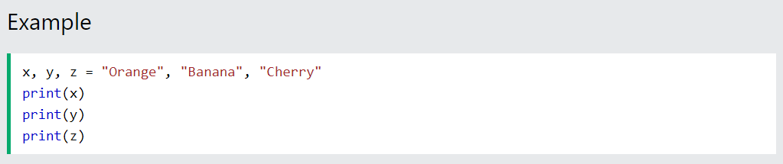
Python Variables - Assign Multiple Values
Many Values to Multiple Variables
Python allows you to assign values to multiple variables in one line:
Note: Make sure the number of variables matches the number of values, or else you will get an error.

Slide 24
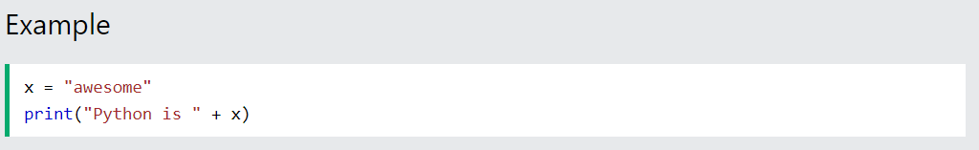
Output Variables
The Python print statement is often used to output variables.
To combine both text and a variable, Python uses the + character:
You can also use the + character to add a variable to another variable:
For numbers, the + character works as a mathematical operator:

Slide 25
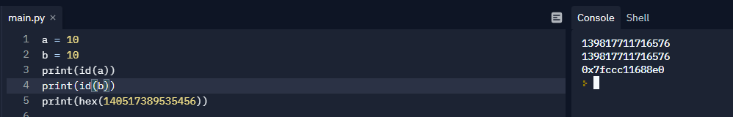
GET THE ADDRESS OF VARABLE FROM RAM
Call id(object) to get the memory address of object . Call hex(address) to convert the memory address to hexadecimal representation.
If there are two variables with the same value then only one box will be created in the memory i.e they will have the same address
For example:
A = 10
B = A
Id(A)
Id(B)
>>>will be same

Slide 26
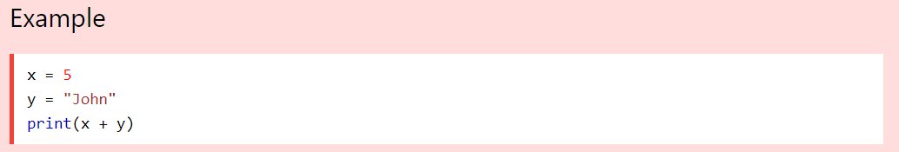
If you try to combine a string and a number, Python will give you an error:

Slide 27
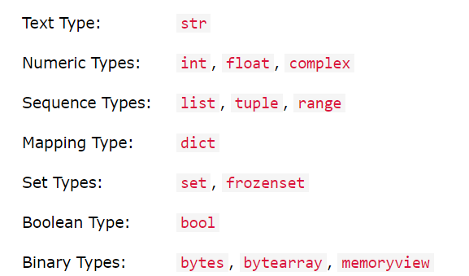
Python Data Types
Built-in Data Types
In programming, data type is an important concept.
Variables can store data of different types, and different types can do different things.
Python has the following data types built-in by default, in these categories:

Slide 28
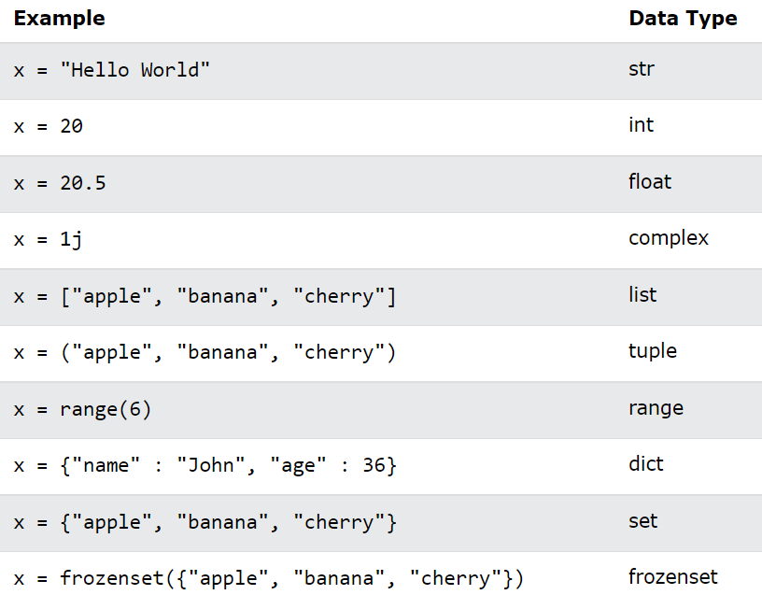
Setting the Data Type
In Python, the data type is set when you assign a value to a variable:

Slide 29
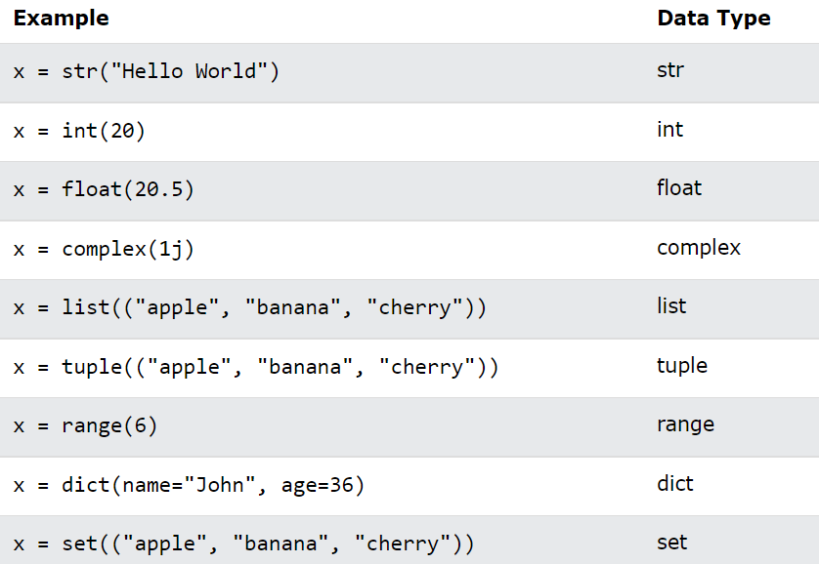
Setting the Specific Data Type
If you want to specify the data type, you can use the following constructor functions:

Slide 30
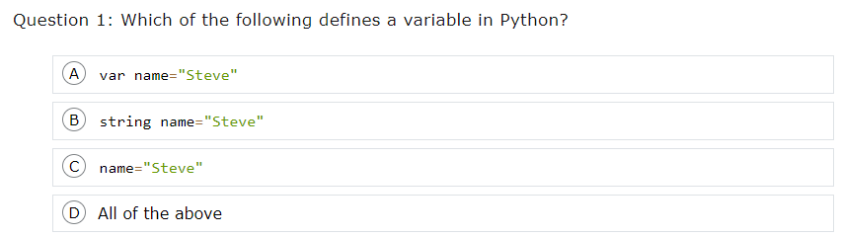
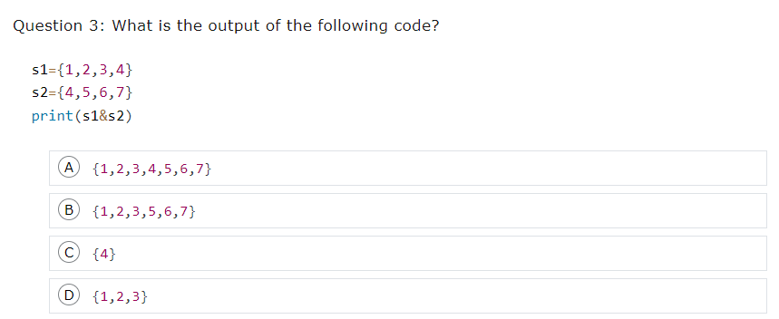
Questions

Slide 31
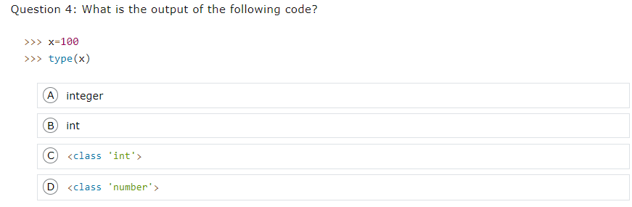
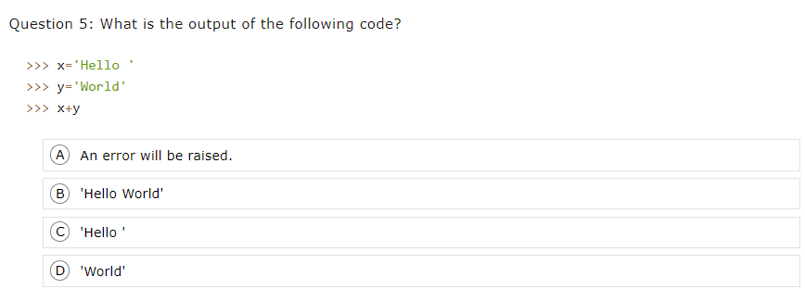

Slide 32
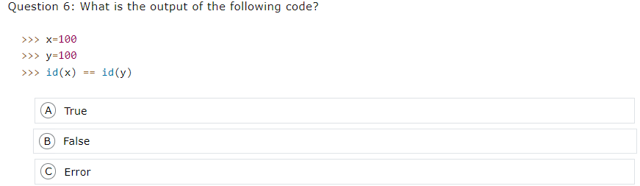
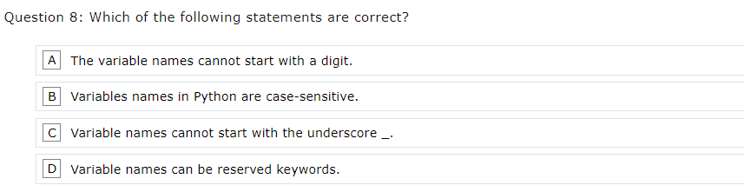

Slide 33
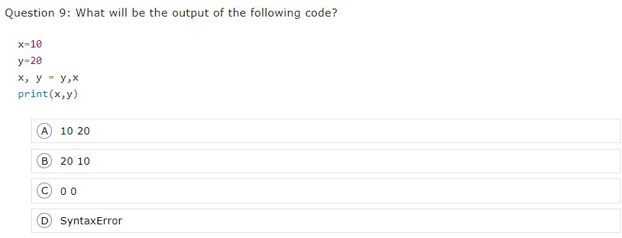
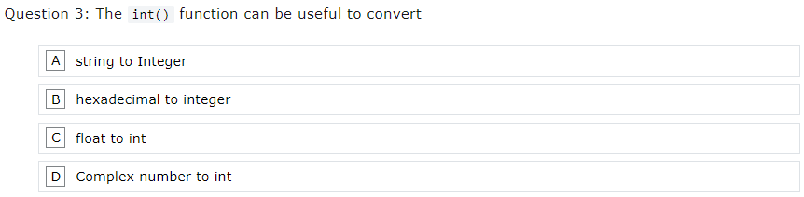

Slide 34
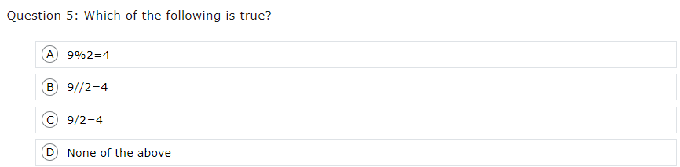

Slide 35
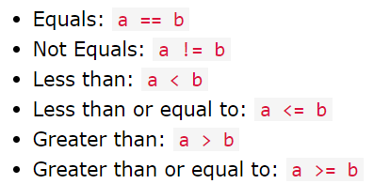
Python If ... Else
Python Conditions and If statements
Python supports the usual logical conditions from mathematics:
These conditions can be used in several ways, most commonly in "if statements" and loops.
An "if statement" is written by using the if keyword.

Slide 36
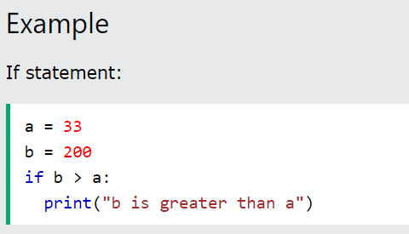
In this example we use two variables, a and b, which are used as part of the if statement to test whether b is greater than a. As a is 33, and b is 200, we know that 200 is greater than 33, and so we print to screen that "b is greater than a".

Slide 37
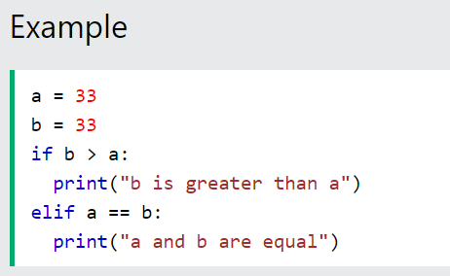
Elif
The elif keyword is pythons way of saying "if the previous conditions were not true, then try this condition".
In this example a is equal to b, so the first condition is not true, but the elif condition is true, so we print to screen that "a and b are equal".

Slide 38
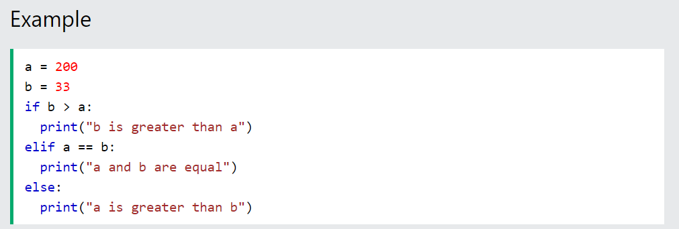
Else
The else keyword catches anything which isn't caught by the preceding conditions.
In this example a is greater than b, so the first condition is not true, also the elif condition is not true, so we go to the else condition and print to screen that "a is greater than b".

Slide 39
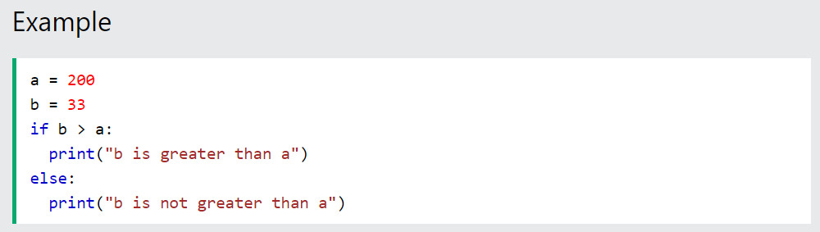
You can also have an else without the elif:

Slide 40
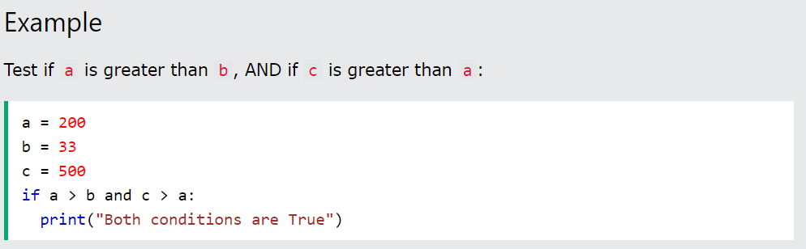
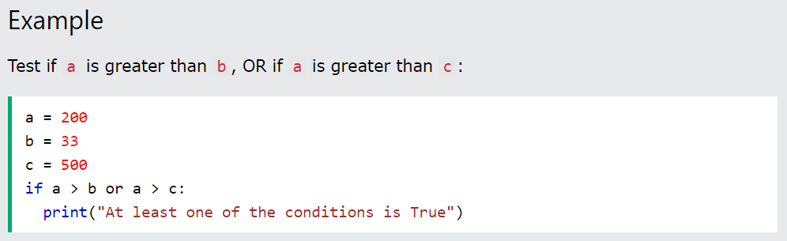
And
The and keyword is a logical operator, and is used to combine conditional statements:
Or
The or keyword is a logical operator, and is used to combine conditional statements:

Slide 41
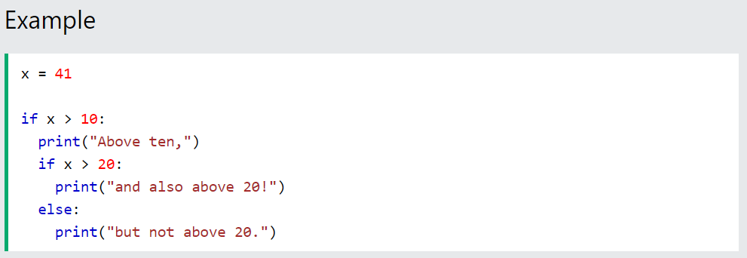
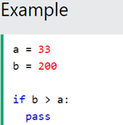
Nested If
You can have if statements inside if statements, this is called nested if statements.
The pass Statement
if statements cannot be empty, but if you for some reason have an if statement with no content, put in the pass statement to avoid getting an error.

